Slide 1
Project 1 presentation

Slide 2
PROBLEM STATEMENT
Analyzing participation rates in ACT (American College Testing) exams can provide insights into several factors, such as demographic trends, educational access, and student preferences over time. Here's a general approach for analyzing ACT participation rates:
Data Collection
Identify Key Metrics
Data Segmentation
Trend Analysis
Statistical Analysis
Visualization

Slide 3
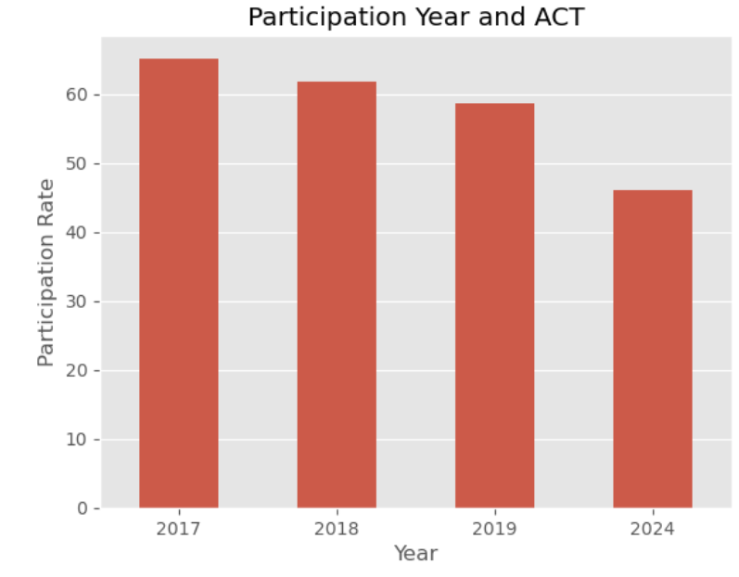

Slide 4
Find state trends and average test scores.
Predict which student are likely to cancel their admission in the near future.

Slide 5
Find state trends and average test scores.
Predict which student are likely to cancel their admission in the near future.

Slide 6
Engaging the audience

Slide 7
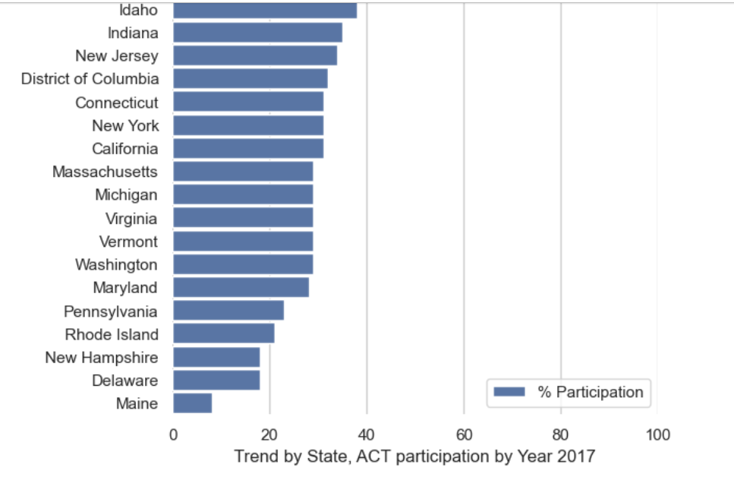
2017 Participation by State < 40%

Slide 8
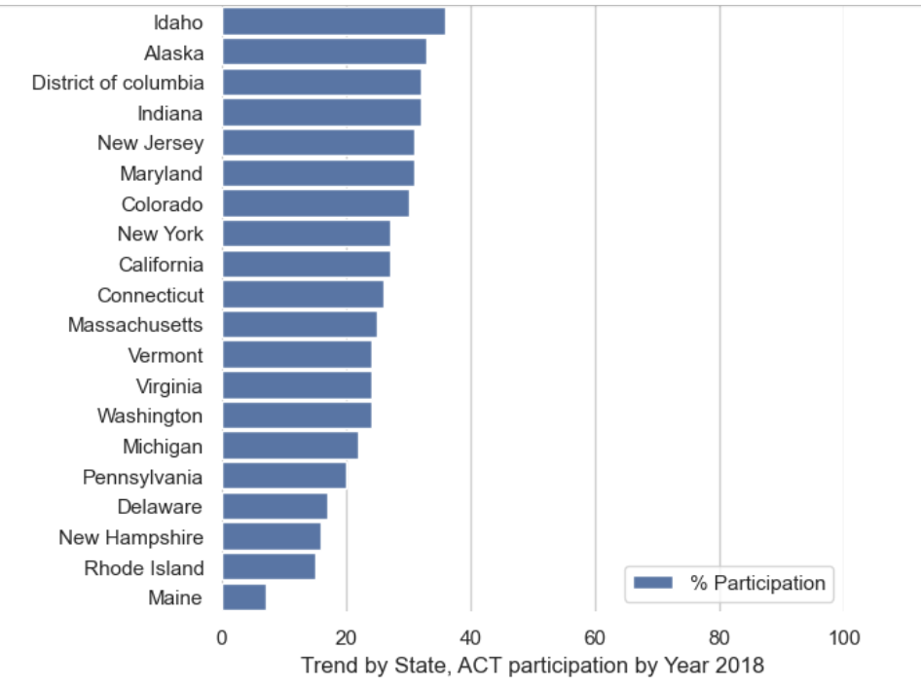
2018

Slide 9
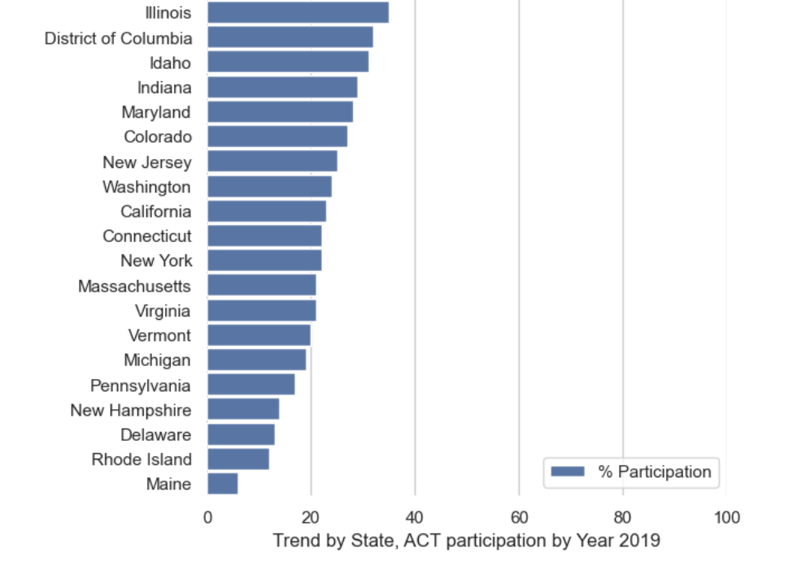
2019

Slide 10

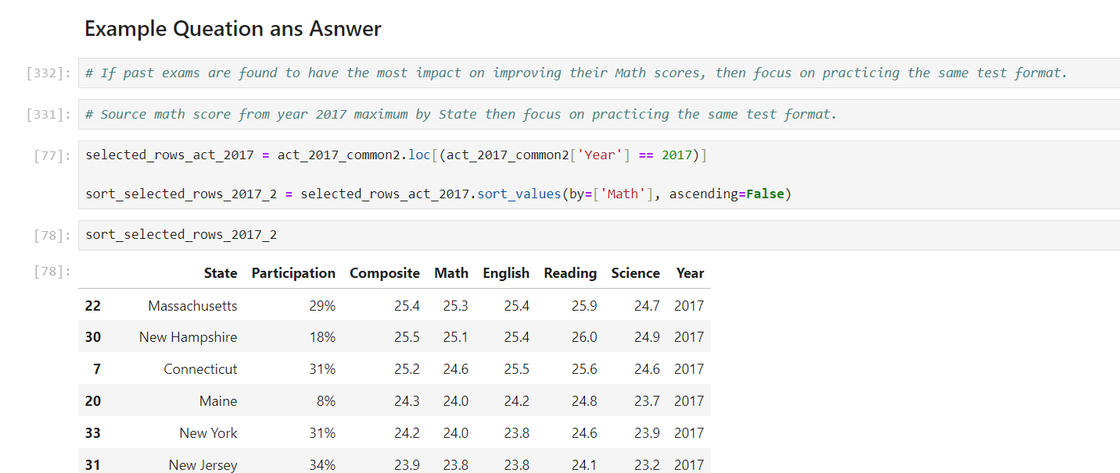
Navigating Q&A sessions

Slide 11
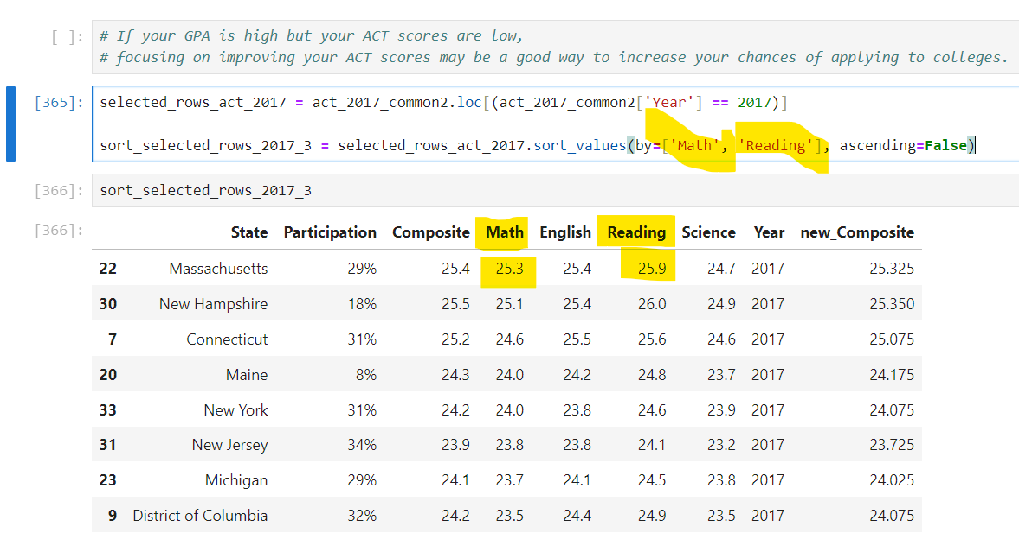

Speaking impact

Slide 12
Final tips & takeaways
A composite score of 28 may place you in the 88th percentile, meaning you scored higher than 88% of test-takers.
High scores in Math and Science suggest strength in quantitative and analytical reasoning.
A score of 32 in Reading might indicate strong verbal comprehension skills.
A score of 26 in Science might suggest areas where more practice in interpreting scientific data could help.
A composite score of 29 might place you in the 91st percentile, meaning you scored higher than 91% of test-takers.
A composite score of 24 might place you in the 74th percentile.
Seek feedback
Reflect on performance
Explore new techniques
Set personal goals
Iterate and adapt

Slide 13
ACT publishes benchmarks that represent scores associated with college success:
Impact factor | Measurement | Target | Achieved
English | Percentage (%) | 18 | >=18
Math | Percentage (%) | 22 | >=22
Reading | Percentage (%) | 22 | >=22
Science | Percentage (%) | 23 | >=23
Composite | Average rating | 36 | >=21.2

Slide 14
Thank you
Taweewattana Prhomkotara (Wee)
0909275573
promakotara@gmail.com

